Slide 1

NI
LECTURE
Windows Server 2016:
Understanding Active Directory
Networking Infrastructure
Diploma in CSF/IT
Year 2 (2022/23), Semester 3
8
Notes:
1

Slide 2
Objectives
At the end of this, you will understand the following:
What is Active Directory?
What is the purpose of Active Directory?
Logical Structure of Active Directory
Building Blocks of Active Directory
What is a Domain Controller?
Notes:
2

Slide 3
What is Active Directory?
Provides a directory services infrastructure that can help organizations manage resources throughout the network.
A network directory that contains objects and resources such as users accounts, computer accounts, groups account, printer, shares and contact information.
Goal:
To provide simplified and efficient system administration.
Works with and requires DNS (Domain name service).
Incorporated into most Windows Server operating system.
Notes:
3

Slide 4
What Is Active Directory?
Active Directory is:
The replacement for Domains in NT 3.x and 4.x
The basis of all Windows Server security
A store of directory/security information
A service that provides:
authorization and authentication
queries and updates of the directory
distribution of the directory across multiple servers
partitioning of the directory
replication of the directory
Notes:
4
Windows Server 2008 (sometimes abbreviated as "Win2K8" or "W2K8").

Slide 5
AD DS: Identity and Access Management
CONTROL
Keeping records
Auditing
Who
Access
Resources
Protection
Assigned
Verify
Access rights
Identity

Slide 6
AD as a Database
AD is a DBMS with many object-oriented features.
Like any DBMS, AD:
Maintains a physical data store (NTDS.DIT).
Is built on a client-server model.
Provides service-level interfaces that enables users and processes to query and update data.
Other concepts of object database apply to AD including:
Objects and classes
Schema
https://technet.microsoft.com/en-sg/library/cc784826(v=ws.10).aspx
Notes:
6

Slide 7
Objects and Object Classes
An AD contains information about objects.
Each object is an instance of an object class, e.g.,
Computers
Users
Groups (of users or other groups)
Shared files or directories
Policies
Each object class has a set of attributes (or properties)
Many object classes are predefined, but new ones can be defined and added to the directory.
Notes:
7

Slide 8
Containers
Every object in the Active Directory is either a container object or a leaf object.
Leaf objects are “ordinary objects” - e.g.,
users
computers
printers
A container object contains other container objects and/or a set of leaf objects
Notes:
8

Slide 9
Domains
A domain:
is a container object
is an independent unit of security
is a distinct database (which may be replicated)
has its own administrator(s)
has an Internet name (more on this later)
has one or more domain controllers
A domain controller is a server that:
maintains a local AD copy, accepts update and query transactions.
provides authentication and authorization services
shares information with other domain controllers
Notes:
9

Slide 10
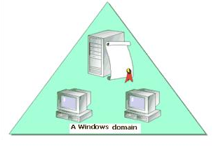
Logical Structure of Active Directory
Based on a system of domains that can be arranged in trees and forests.
Domain is the building block of Active Directory.
A domain consists of a least one domain controller, and this machine will typically be the first on the network.
Example of domain name is NAM.com
Notes:
10

Slide 11
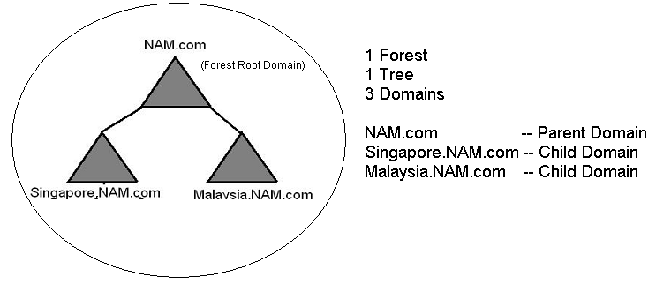
Understanding Domain Structure
A tree is an arrangement of Active Directory domains that share a contiguous namespace (e.g. NAM.com and Singapore.NAM.com).
A single tree is made up of a single domain or multiple domains.
An example of a single tree with three domains:
NAM.com
Singapore.NAM.com
Malaysia.NAM.com
Name of child domains are consistent with the parent domain. Considered a single namespace.
Notes:
11

Slide 12
Understanding Domain Structure
A forest is the entire Active Directory structure for an organization.
Collection of Trees.
Hierarchy of domains forming a contiguous or disjoint namespace.
An example of a disjoint namespace is DIV1.COM and DIV2.COM (the namespace does not form a contiguous hierarchy).
Notes:
12

Slide 13
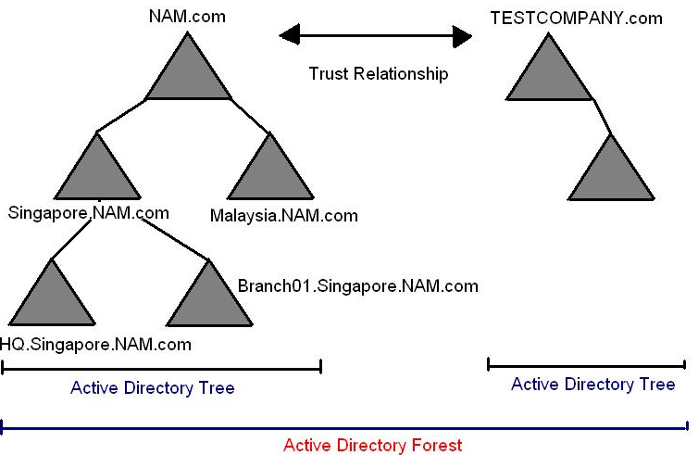
Understanding Domain Structure
Within a forest, there can be multiple trees.
A single forest with 2 trees with 7 domains.
NAM partnered with another company and the second company wanted to maintain its own namespace. A new tree is created in the same forest.
Notes:
13

Slide 14
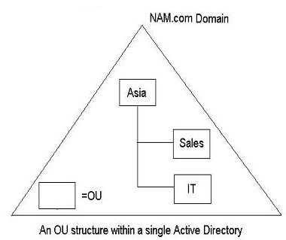
Understanding Organizational Units
Domains can be created & configured to reflect the business and technical needs of an organization.
This information can be structured into logical containers called OUs (organization units)
OU are Active Directory objects that serve as containers for other objects e.g. user, computer.
Example: Create OUs named “Sales” and “IT” within your organization's domain.
Place AD objects such as users, computers and groups within OUs.
Notes:
14

Slide 15
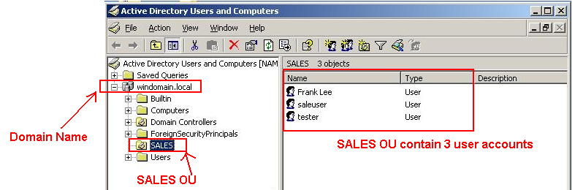
Understanding Organizational Units
Benefit :
Allow administrators to easily organize and manage AD objects
Main Uses of OUs:
Delegation: Delegate a user in the OUs to perform certain tasks (e.g. reset password).
Group Policies: Can apply policies to group of users or computers based upon the needs of business e.g. SALES
Notes:
15

Slide 16
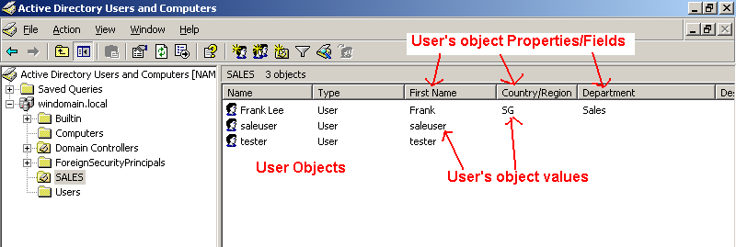
Active Directory
Object based central repository for all user accounts, group accounts, printer, computer accounts, shared folders and etc…
Active Directory is built on Objects, Properties and Values.
An object represents a network resource.
An object is any logical representation of a physical entity.
e.g. Frank, a user in the network, is represented in Active Directory as a user object named Frank Lee
Frank Lee user object is made up of multiple properties/fields e.g. Name, Type, First Name.
“Frank” entered in the First Name field is considered as the value.
The principle is applied to other objects like printer and computer objects.
Notes:
16

Slide 17
AD Domains and the Internet
Each AD domain is an entity defined within:
the active directory - AND -
the Internet
Each AD domain must have an Internet name because:
Clients access AD servers and services via Internet standard names (e.g. npstd.np.edu.sg)
TCP/IP, the standard Internet protocol, is also the standard Window Server protocol
Notes:
17

Slide 18
Active Directory - Technology & Standards
Lightweight Directory Access Protocol (LDAP)
LDAP is an Internet standard for directory access.
X.500
X.500 is an ISO standard for directory structure, content, and access.
Active Directory follows most of the standard for structure and content but not for access.
Domain Name System (DNS)
DNS is an Internet standard for object naming.
All Active Directory domains are DNS host names.
Notes:
18

Slide 19
Active Directory - Tool
Administrator role is to set these AD values – configuring these values through the Active Directory Users and Computers tool.
Notes:
19

Slide 20
AD and Windows Servers
Windows servers can have three different types of relationships to AD:
Stand-alone server – has no relationship to an AD domain, has only local (machine) accounts and resources – secure, but not scalable
Member server – is a member of an AD domain but has no local copies of the AD database and runs no AD services – typically manages specific resources (e.g. a website or database) in a multiple server environment.
Domain controller – stores a local copy of the AD database, synchronizes changes with other domain controllers, and responds to AD service requests
Notes:
20

Slide 21
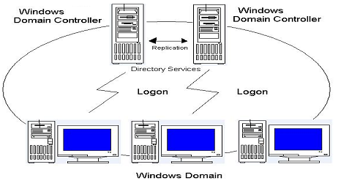
Domain Controllers
Active Directory can be replicated across multiple domain controllers allowing for redundancy
A Windows Server 2016 with Active Directory installed.
Every domain must have at least one domain controller contained within it.
Maintain a copy of the Active Directory database.
Provide authentication/logon services to users as they log into Active Directory domain.
More than one domain controller for fault tolerance (backup)
Changes (add/remove user objects) at one domain controller are replicated to all domain controllers so that database is consistent.
Notes:
21

Slide 22
AD Replication (Dis)advantages
Advantages of multiple domain controllers:
Fault tolerance
Improved performance in segmented or widely distributed networks
Inherently scalable
Disadvantages of multiple domain controllers:
Cost – e.g. hardware, MS client access license (CALs)
Synchronization delays
Synchronization bandwidth
Notes:
22

Slide 23
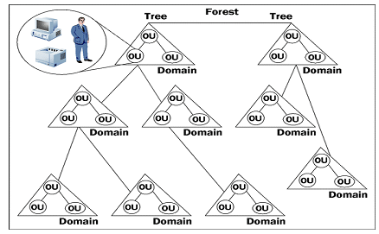
Summary
Directory Service for Windows Server 2016 is called Active Directory.
Active Directory is based on domains, trees and forests.
Notes:
23
The directory service for Windows 2000 is called Active Directory.

Slide 24
Reading Reference
https://docs.microsoft.com/en-us/windows-server
Notes:
24

